Slide 1
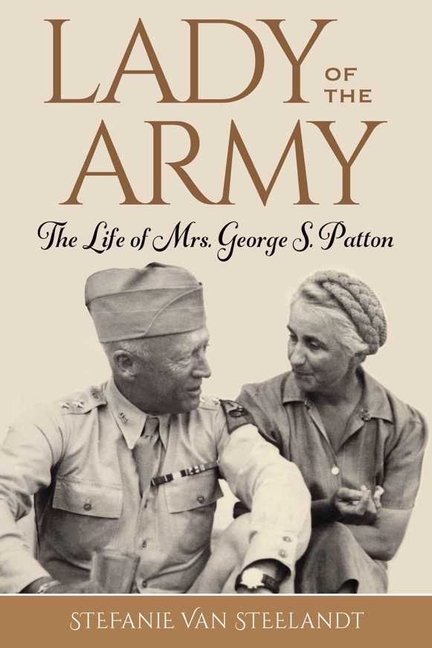
“How high can a kite soar without its tail?”

Slide 2
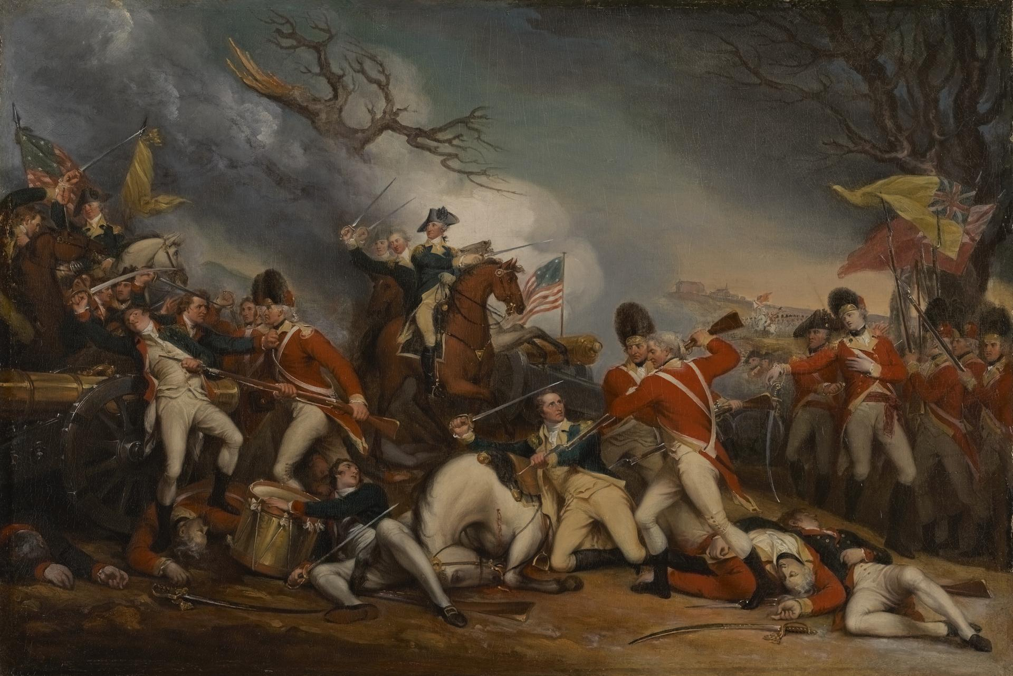
The Death of General Mercer at the Battle of Princeton, January 3, 1777
By John Trumbull (Yale University Art Gallery)

Slide 3
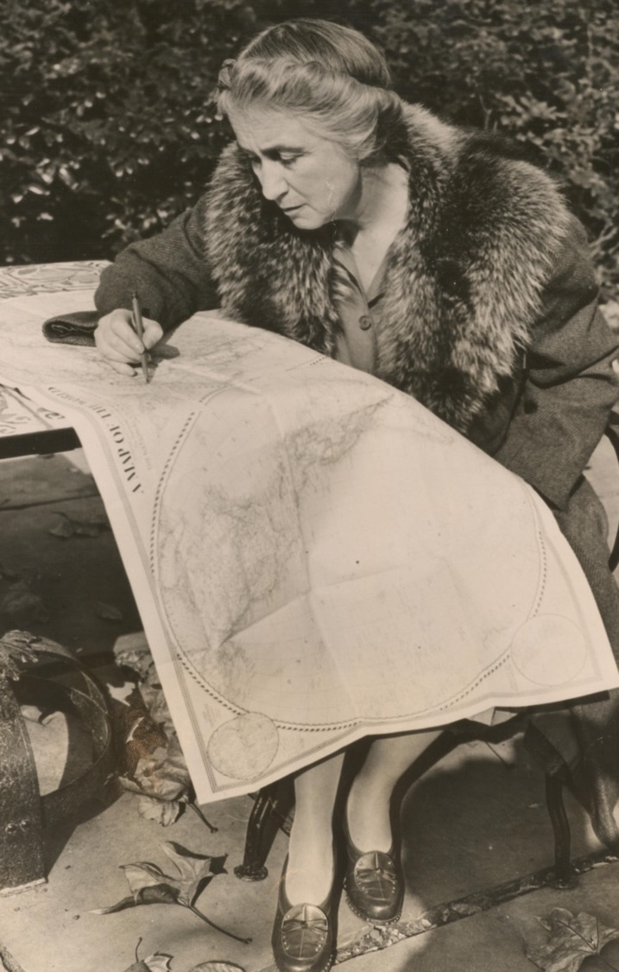
I wish there was a book about Bea, because she truly was a remarkable person. Even just reading a little about her uncle and father, there is a story there. Maybe I should be the one writing it?
– Stefanie Van Steelandt
January 20, 2018

Slide 4
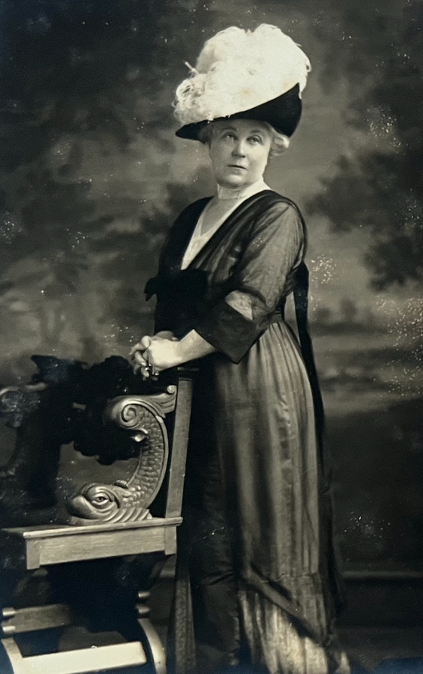
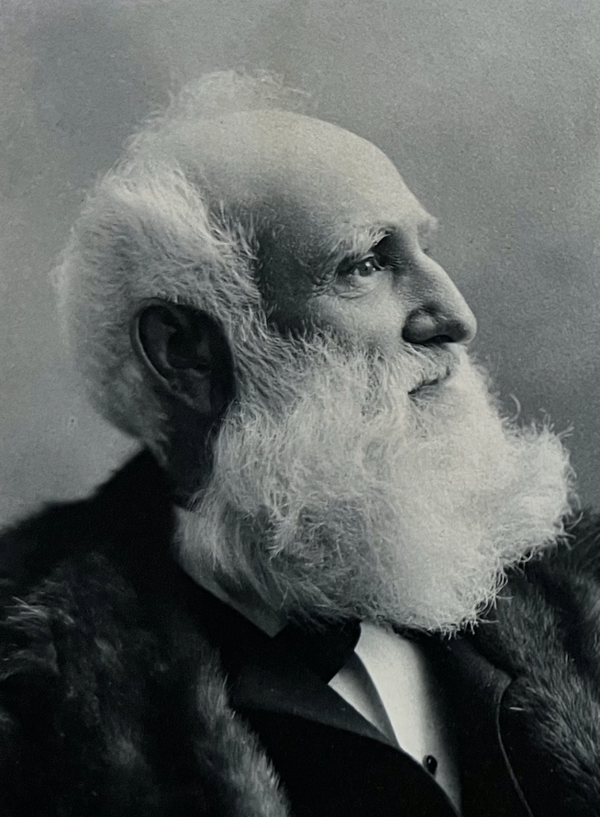
Frederick Fanning Ayer
(1822 – 1918)
Ellen Banning Ayer
(1853 – 1918)

Slide 5
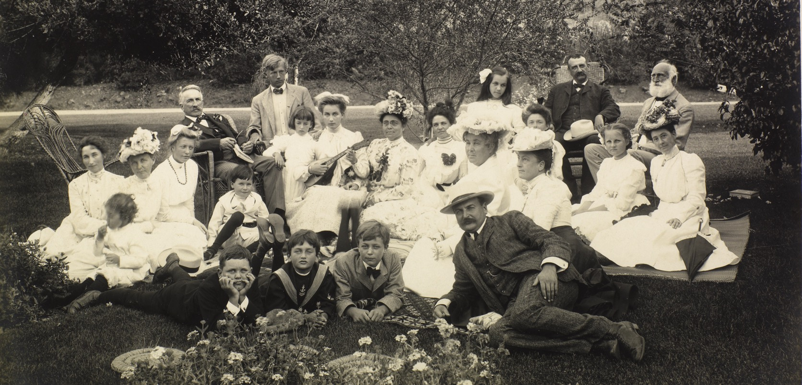
Catalina Island, California – Summer of 1902
The Ayers, Bannings, and Pattons (Huntington Library)

Slide 6
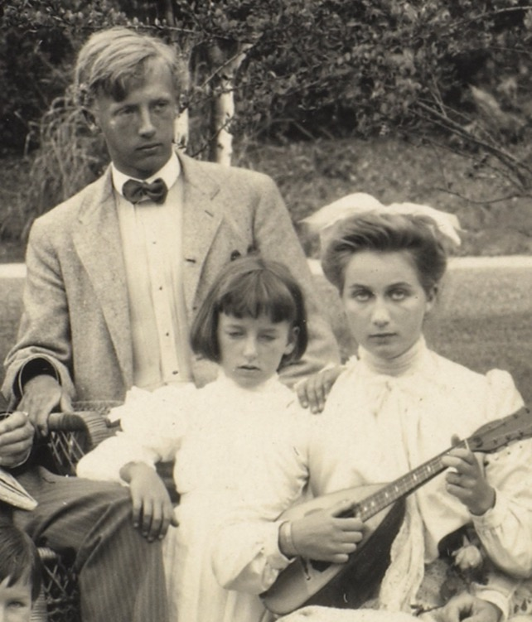
“
There was a rebel inside the pampered society girl, and that rebel fell in love with another rebel.

Slide 7
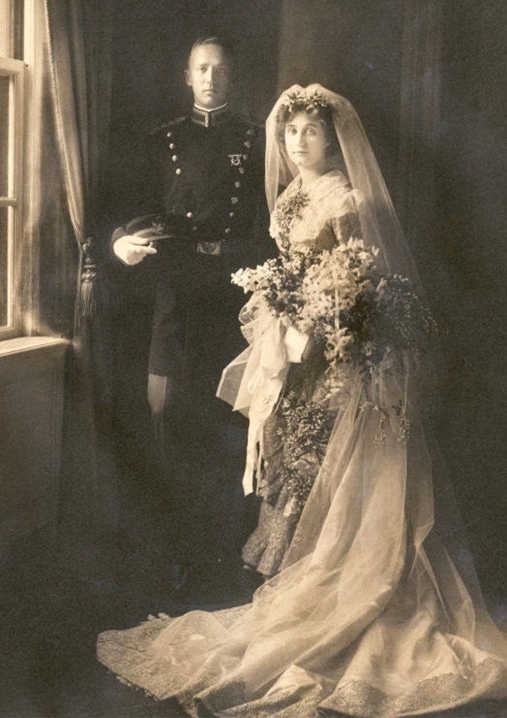
“May our love never be less than now and our ambition as fortunate and as great as our love.”
- GSP to BAP
May 22, 1910
SHE SHAPED THE MAN.
Beverly Farms, Massachusetts
May 26, 1910

Slide 8
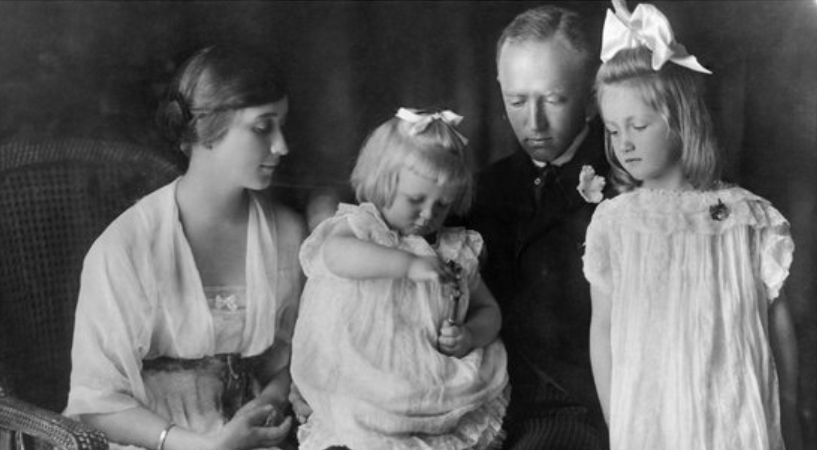

Slide 9
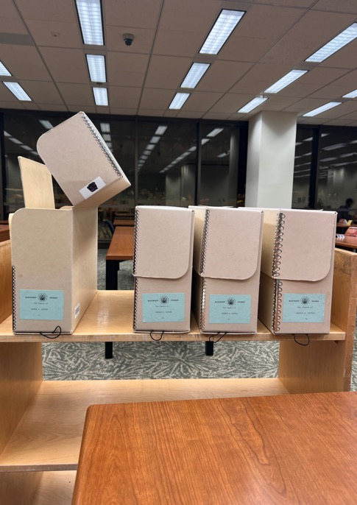
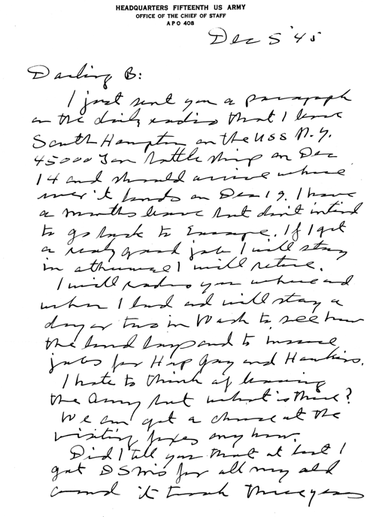
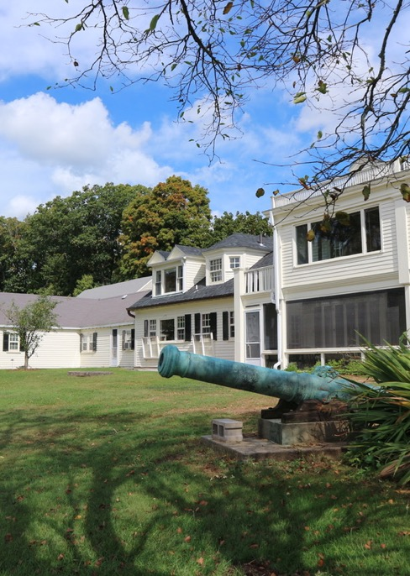
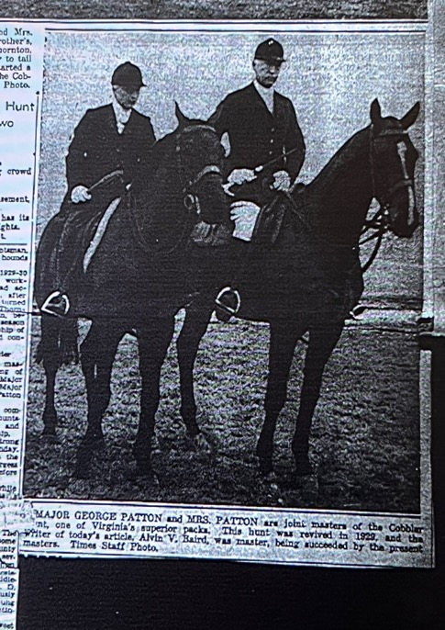
Writing a biography requires a certain degree of obsessiveness that takes hold the moment you realize you have met your subject.

Slide 10
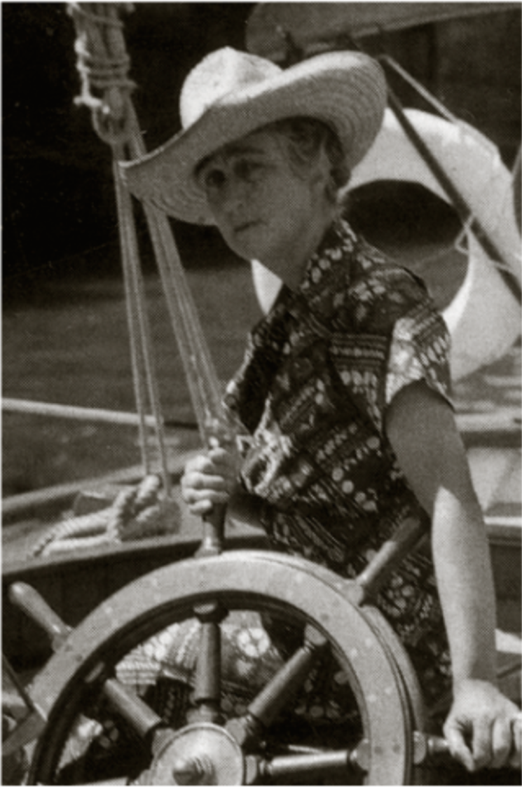
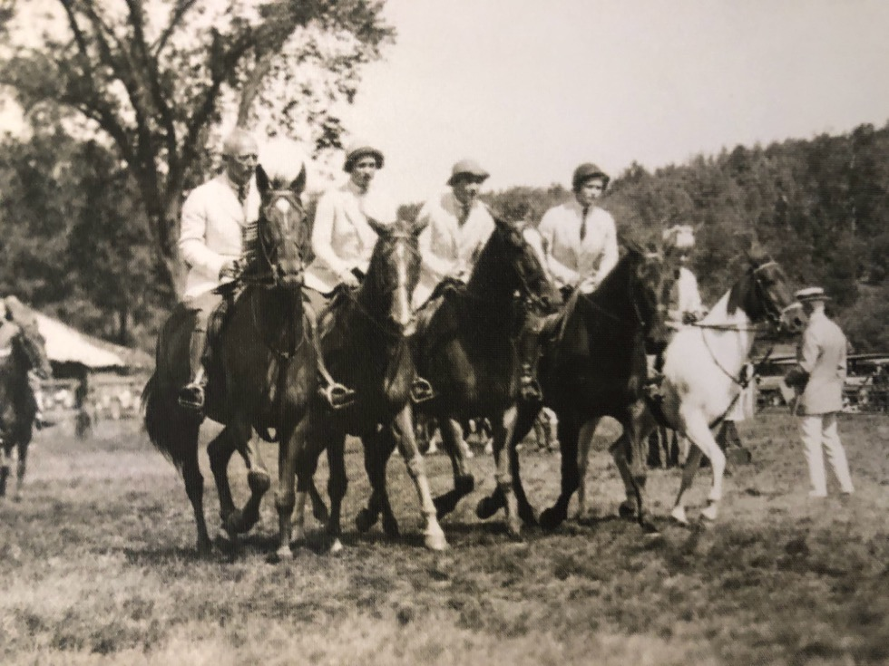
SHE FORTIFIED THE SOLDIER.
George, Little Bee, Beatrice, Ruth Ellen, and George IV.
Myopia Club, South Hamilton, Massachusetts

Slide 11
Release Party for Blood of the Shark
Honolulu, Hawaii – December 1936

Slide 12
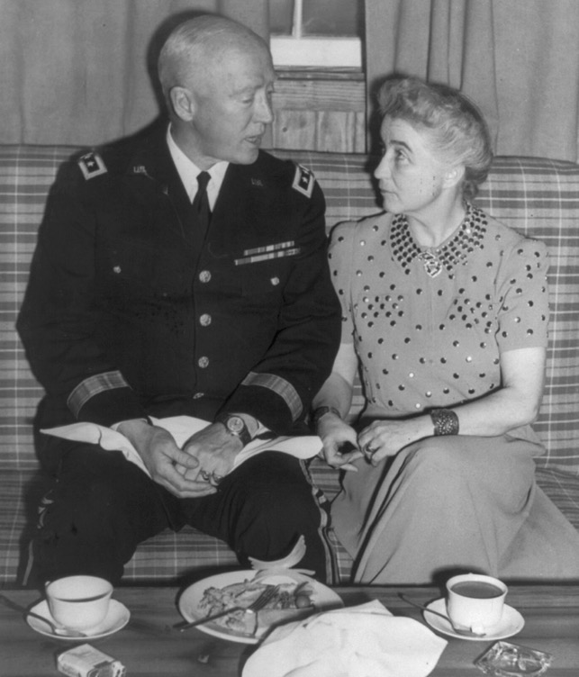
“
To have George safe at home would have meant bouts of unhappiness like he had experienced intermittently over the last twenty-four years; to have him participate in the biggest war in history meant years of waiting and anxiety for her.

Slide 13
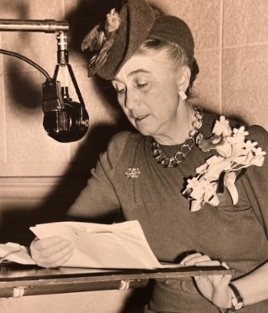
“I do not know where my husband is tonight. I should like to be a soldier fighting with them, or a nurse fighting for them, but as it is, I am the wife and mother and grandmother of soldiers and soldiers-to-be, and I must fight the war here on the home front behind the lines.”
- BAP Speech, September 1943

Slide 14
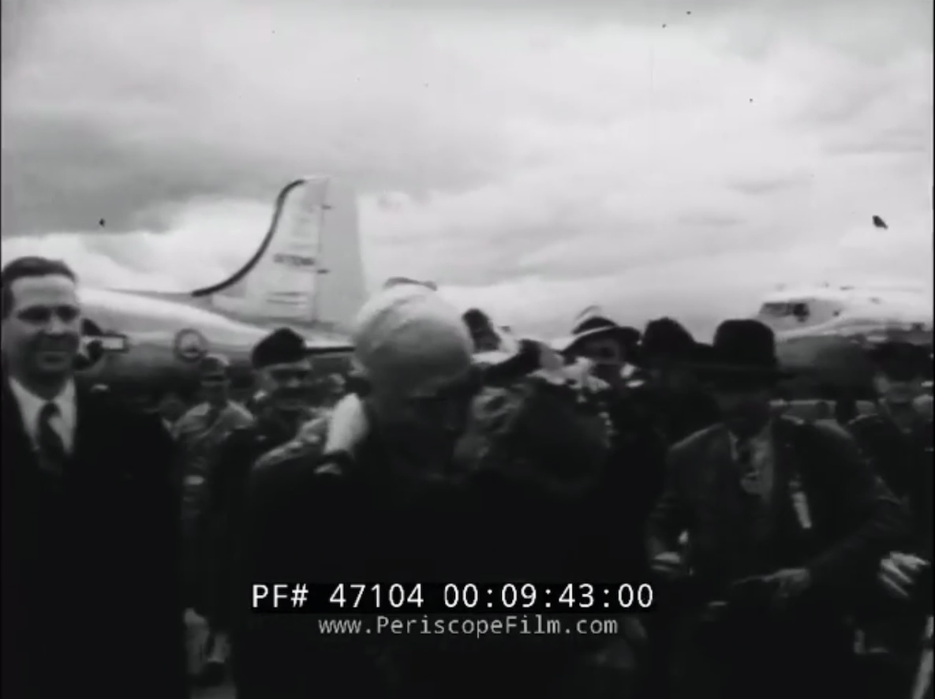
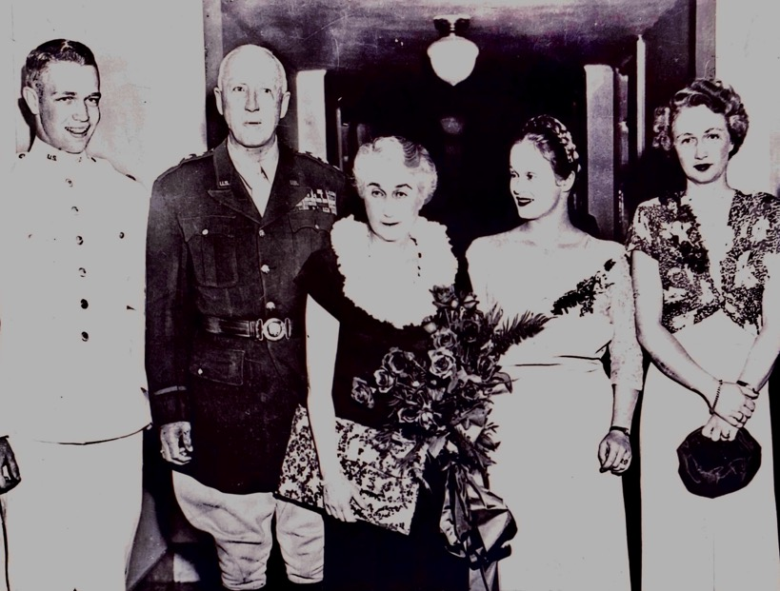
Boston, MA
June 7, 1945
The Patton Family: George IV, George, Beatrice, Ruth Ellen, and Little Bee.

Slide 15
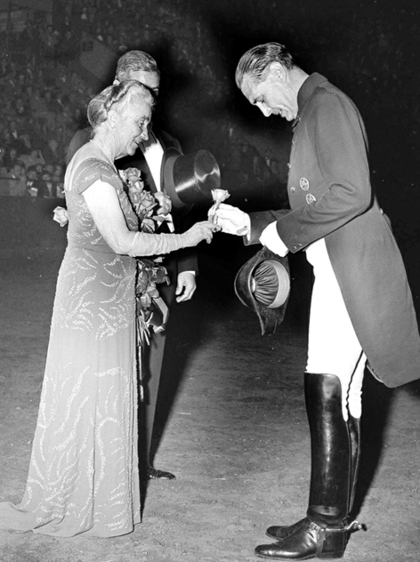
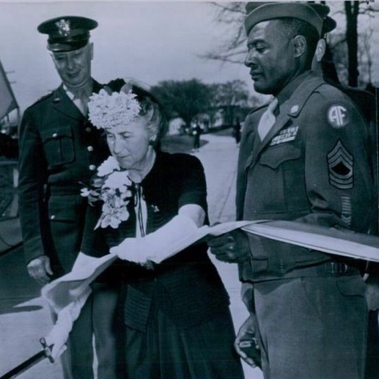
SHE CREATED THE LEGEND.
Inaugurating Patton Road at Arlington Cemetery
with the General’s trusty aide (right), Sergeant Meeks.
“
George’s reputation was Beatrice’s “most cherished memory.”
Beatrice and Col. Podhajsky,
Director of the Spanish Riding School, on November 8, 1950, at Madison Square Garden.

Slide 16
Interested People are interesting.
Beatrice Ayer Patton
1886 - 1953

